Slide 1


Ahad Abbaszadeh Azar
2023 - August
https://github.com/absze/Capstone

Slide 2


Outline
Executive Summary
Introduction
Methodology
Results
Conclusion
Appendix

Slide 3
Executive Summary
Data collection
Data wrangling
EDA with data visualization
EDA with SQL
Building an interactive map with Folium
Building a Dashboard with Plotly Dash
Predictive analysis (Classification)
EDA results
Interactive analytics
Predictive analysis
Summary of methodologies
Summary of all results

Slide 4
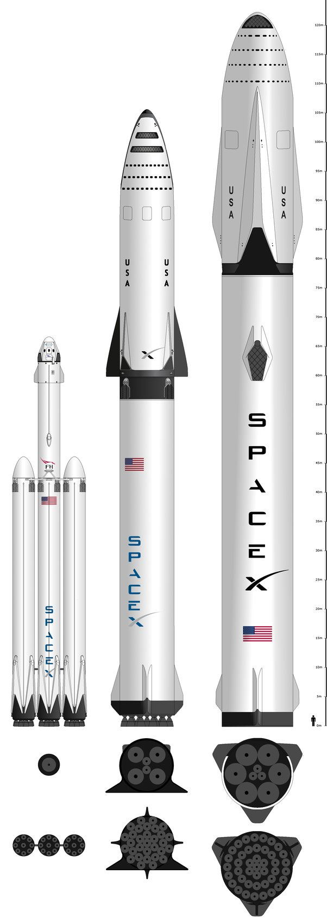

Introduction
Project background and context
SpaceX advertises Falcon 9 rocket launches on its website, with a cost of 62 million dollars; other providers cost upward of 165 million dollars each, much of the savings is because SpaceX can reuse the first stage.
Problems you want to find answers
The project task is to predicting if the first stage of the SpaceX Falcon 9 rocket will land successfully.

Slide 5

Section 1

Slide 6
Methodology
One Hot Encoding data fields for Machine Learning and data cleaning of null values and irrelevant columns
Perform exploratory data analysis (EDA) using visualization and SQL
Perform interactive visual analytics using Folium and Plotly Dash
Perform predictive analysis using classification models
LR, KNN, SVM, DT models have been built and evaluated for the best classifier
Perform data wrangling
SpaceX Rest API
Web Scrapping from Wikipedia
Data collection methodology
Executive Summary

Slide 7

Data Collection
Use SpaceX Rest API
Returns SpaceX data in Json
Normalize data into csv file
Get HTML Response from Wikipedia
Extract data using beautiful soup
Normalize data into csv file
Ready for data consolidation & wrangling
SpaceX launch data that is gathered from the SpaceX REST API.
This API will give us data about launches, including information about the rocket used, payload delivered, launch specifications, landing specifications, and landing outcome.
The SpaceX REST API endpoints, or URL, starts with api.spacexdata.com /v4
Another popular data source for obtaining Falcon 9 Launch data is web scraping Wikipedia using Beautiful Soup.

Slide 8



Data Collection – SpaceX API
Request API and parse the SpaceX launch data
SpaceX offers a public API from where data can be obtained and then used;
This API was used according to the flowchart beside and then data is persisted.
Filter data to only include Falcon 9 launches
Deal with Missing Values

Slide 9


Data Collection - Scraping
Request the Falcon9
Launch Wiki page
Data from SpaceX launches can also be obtained from Wikipedia;
Data are downloaded from Wikipedia according to the flowchart and then persisted.
Extract all column/variable names from the HTML table header
Create a data frame by parsing the launch HTML tables

Slide 10




Data Wrangling
Initially some Exploratory Data Analysis (EDA) was performed on the dataset.
Then the summaries launches per site, occurrences of each orbit and
occurrences of mission outcome per orbit type were calculated.
Finally, the landing outcome label was created from Outcome column.
Creation of Landing Outcome Label
EDA
Summarizations

Slide 11
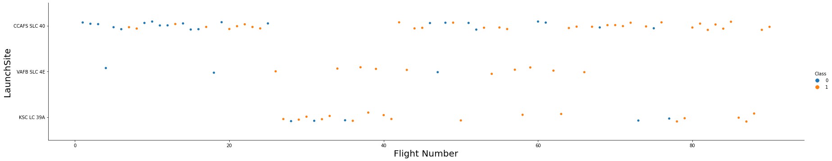
EDA with Data Visualization
To explore data, scatterplots and barplots were used to visualize the relationship between pair of features:
Payload Mass X Flight Number, Launch Site X Flight Number, Launch Site X Payload Mass, Orbit and Flight Number, Payload and Orbit

Slide 12
EDA with SQL
Displaying the names of the unique launch sites in the space mission
Displaying 5 records where launch sites begin with the string 'KSC
Displaying the total payload mass carried by boosters launched by NASA (CRS)
Displaying average payload mass carried by booster version F9 v1.1
Listing the date where the successful landing outcome in drone ship was achieved.
Listing the names of the boosters which have success in ground pad and have payload mass greater than 4000 but less than 6000
Listing the total number of successful and failure mission outcomes
Listing the names of the booster versions which have carried the maximum payload mass
Listing the records which will display the month names, successful landing outcomes in ground pad booster versions, launch site for the months in year 2017
Ranking the count of successful landing outcomes between the date 2010 06 04 and 2017 03 20 in descending order.

Slide 13
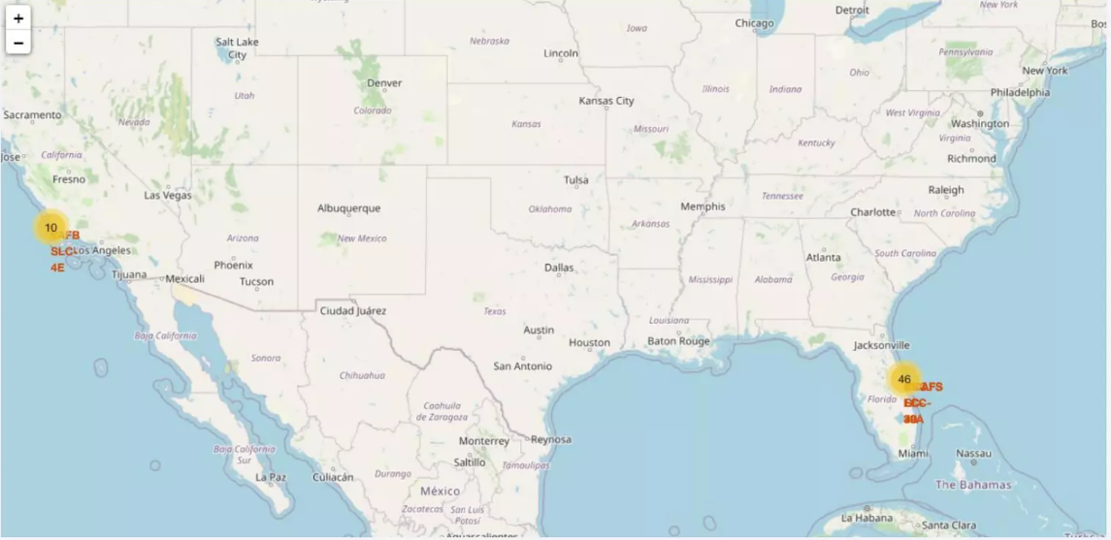
Build an Interactive Map with Folium

Slide 14
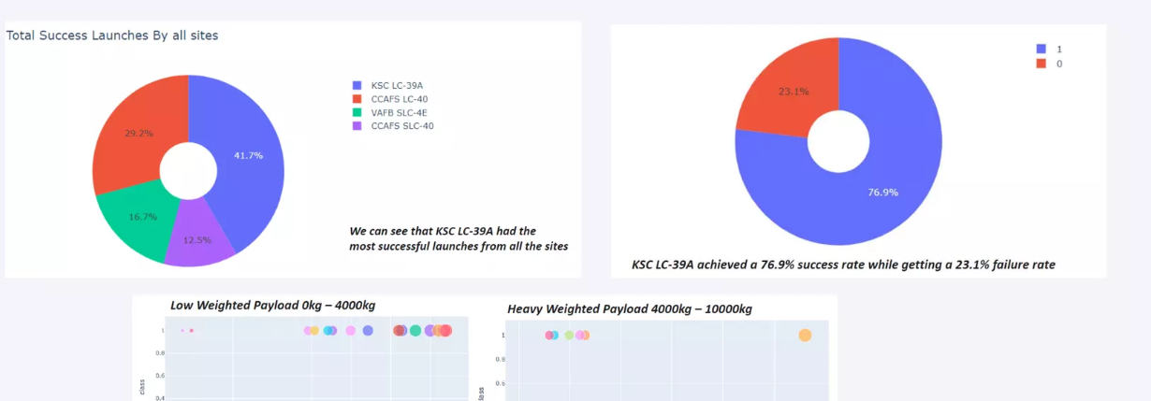
Dashboard with Plotly Dash

Slide 15





Predictive Analysis (Classification)
Four classification models were compared: logistic regression, support vector machine, decision tree and k nearest neighbors.
Test of each model with combinations of hyperparameters
Data preparation and standardization
Comparison of results

Slide 16
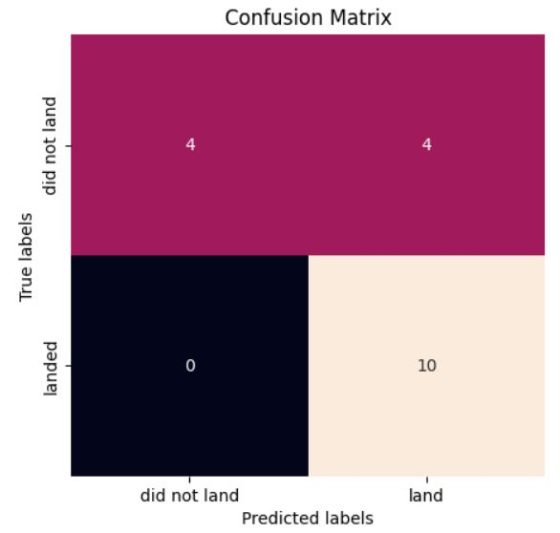

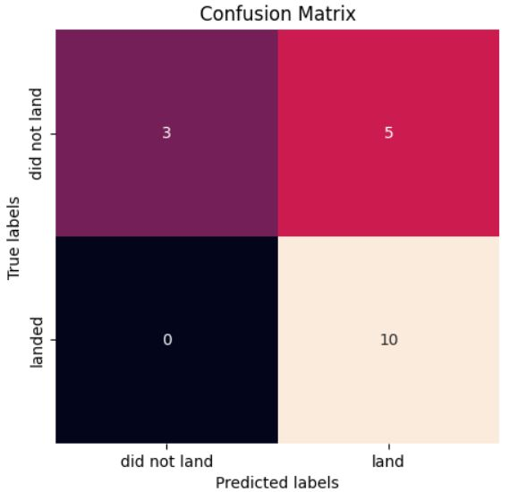
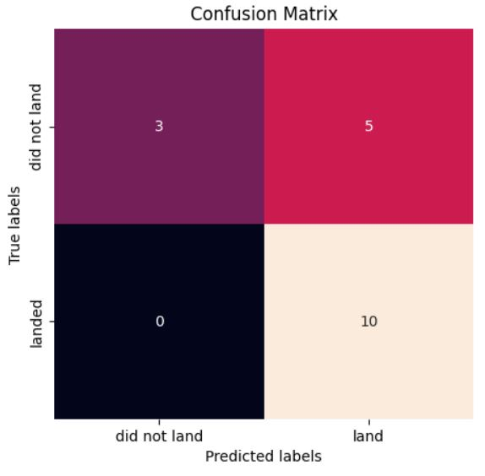
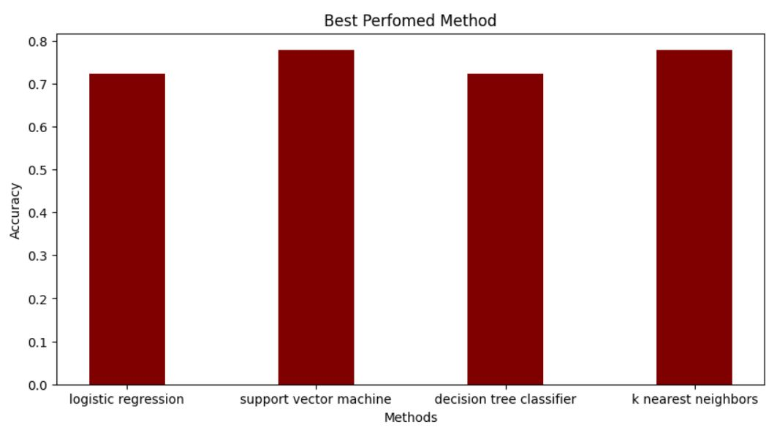
Predictive Analysis (Classification)
The SVM, KNN, and Logistic Regression model achieved the highest accuracy at 83.3%, while the SVM performs the best in terms of Area Under the Curve at 0.958.

Slide 17
Results
The SVM, KNN, and Logistic Regression models are the best in terms of prediction accuracy for this dataset.
• Low weighted payloads perform better than the heavier payloads.
The success rates for SpaceX launches is directly proportional time in years they will eventually perfect the launches.
KSC LC 39A had the most successful launches from all the sites.
• Orbit GEO,HEO,SSO,ES L1 has the best Success Rate.
Results

Slide 18

Section 2

Slide 19
Flight Number vs. Launch Site
According to the plot above, it’s possible to verify that the best launch site
nowadays is CCAF5 SLC 40, where most of recent launches were successful;
In second place VAFB SLC 4E and third place KSC LC 39A;
It’s also possible to see that the general success rate improved over time.

Slide 20
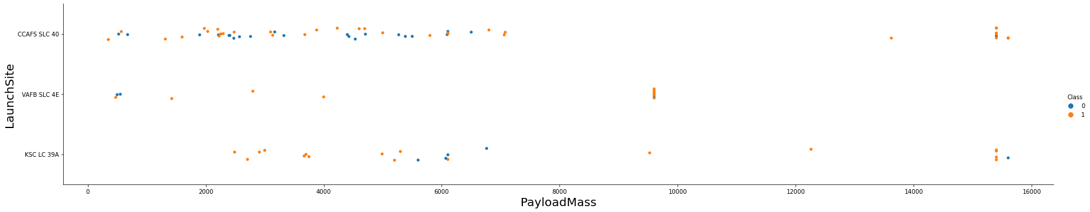
Payload vs. Launch Site
Payloads over 9,000kg (about the weight of a school bus) have excellent success
rate;
Payloads over 12,000kg seems to be possible only on CCAFS SLC 40 and KSC LC
39A launch sites.

Slide 21
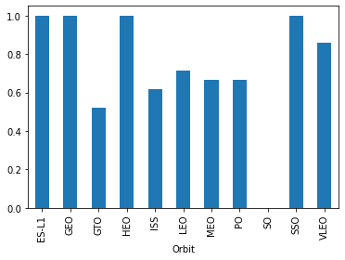
Success Rate vs. Orbit Type
The biggest success rates happens to orbits:
ES-L1;
GEO;
HEO; and
SSO.
Followed by:
VLEO (above 80%); and
LFO (above 70%).

Slide 22
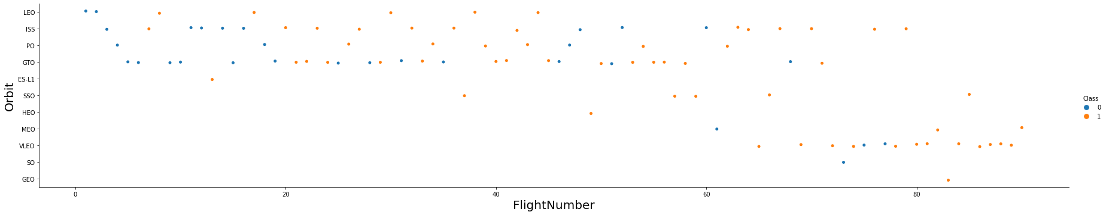
Flight Number vs. Orbit Type
Apparently, success rate improved over time to all orbits;
VLEO orbit seems a new business opportunity, due to recent increase of its
frequency.

Slide 23
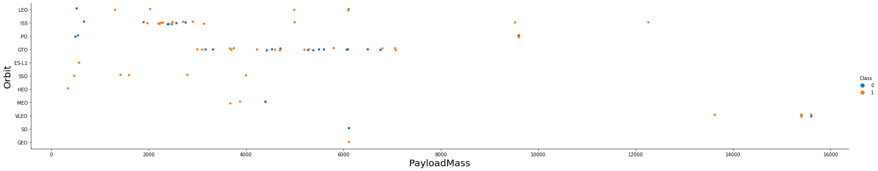
Payload vs. Orbit Type
Apparently, there is no relation between payload and success rate to orbit GTO;
ISS orbit has the widest range of payload and a good rate of success;
There are few launches to the orbits SO and GEO.

Slide 24
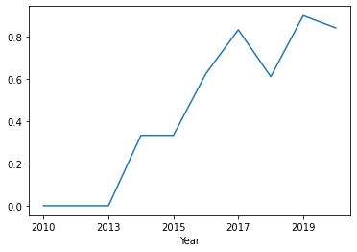
Launch Success Yearly Trend
Success rate started increasing in 2013 and
kept until 2020;
It seems that the first three years were a period of adjusts and improvement of technology.

Slide 25
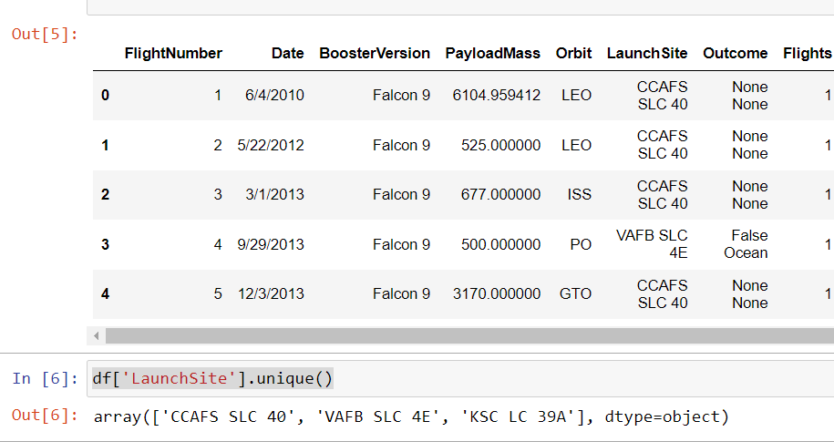
All Launch Site Names
There are three different LaunchSite here

Slide 26
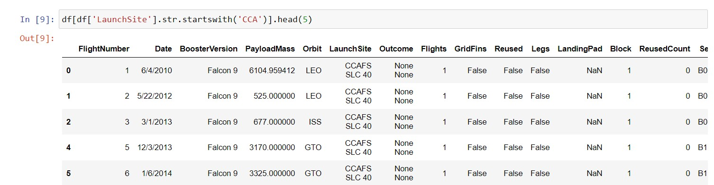
Launch Site Names Begin with 'CCA'
The following code presented in the table displaying five rows from the LaunchSite column that start with 'CCA' by using the associated code.

Slide 27
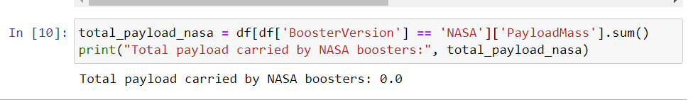
Total Payload Mass
From related calculation, the total PayLoadMass carried by boosters from
NASA was zero

Slide 28
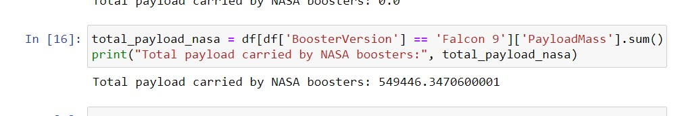
Average Payload Mass by F9 v1.1
From related calculation, the total PayLoadMass carried by boosters from NASA was 549446.3470600001

Slide 29
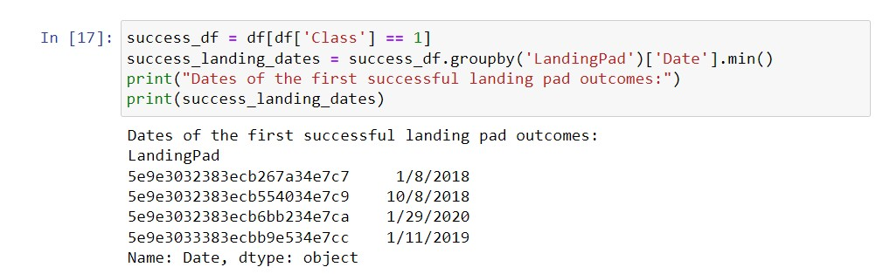
First Successful Ground Landing Date
The dates of the first successful landing outcome on ground pad were shown here:

Slide 30
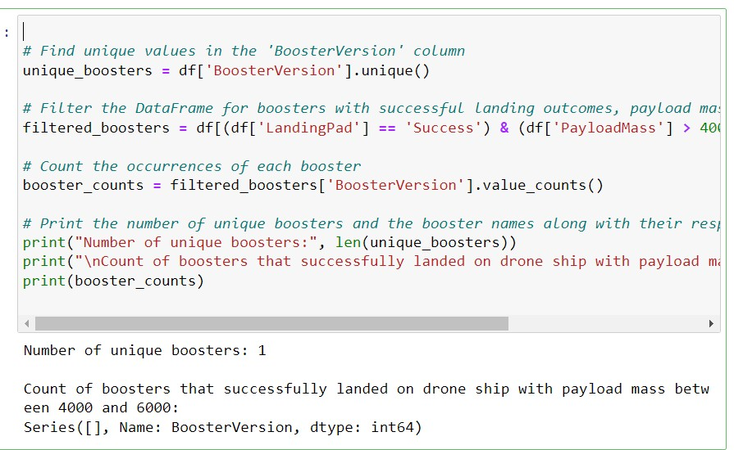
Successful Drone Ship Landing with Payload between 4000 and 6000

Slide 31
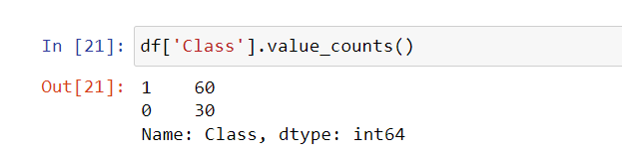
Total Number of Successful and Failure Mission Outcomes
The total number of successful and failure mission outcomes is placed in the
Class column which has 60 success and 30 failure

Slide 32
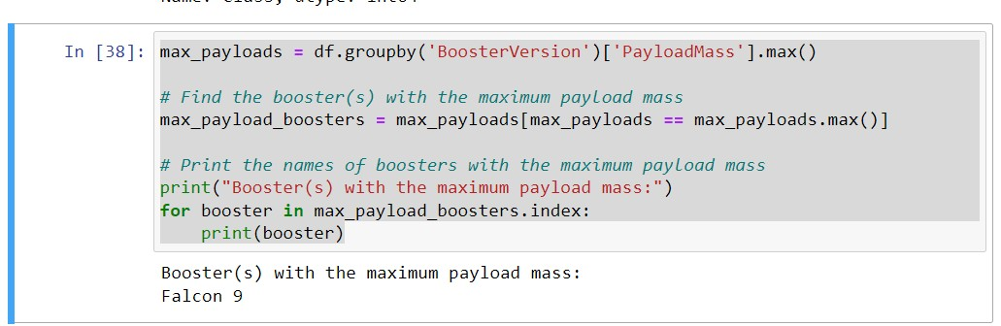
Boosters Carried Maximum Payload

Slide 33
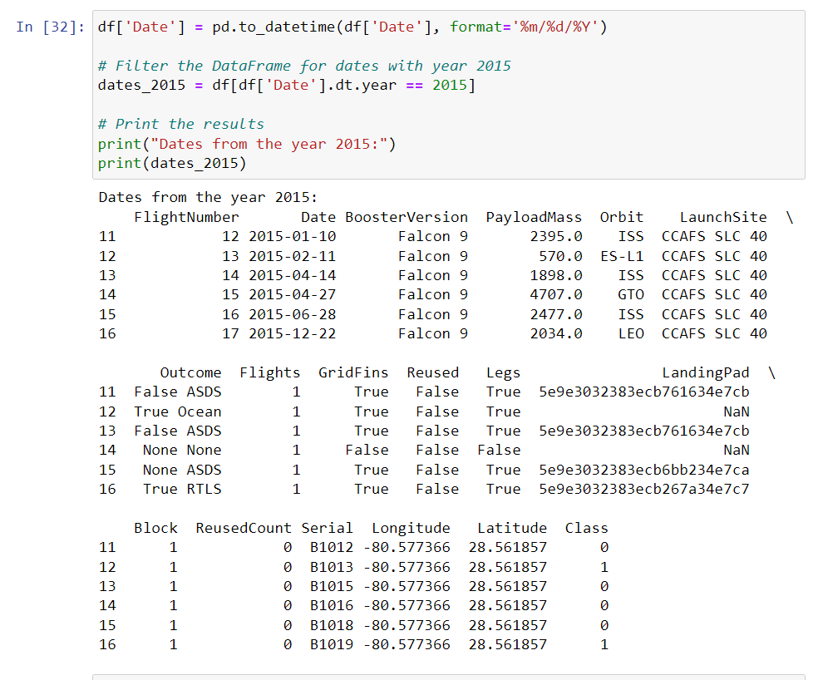
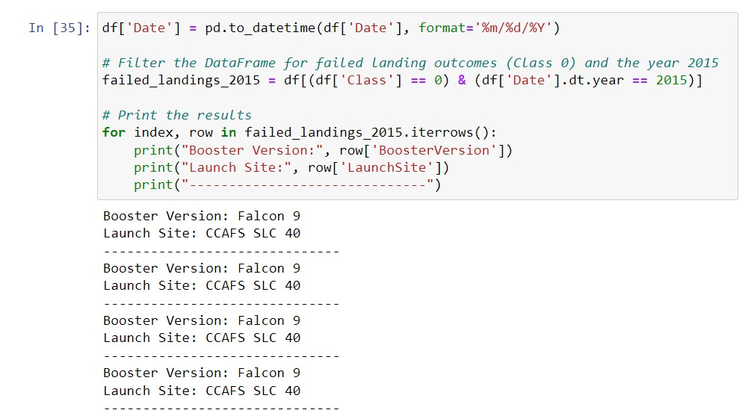
2015 Launch Records
Here there is a list the failed landing_outcomes in drone ship, their booster
versions, and launch site names for in year 2015

Slide 34
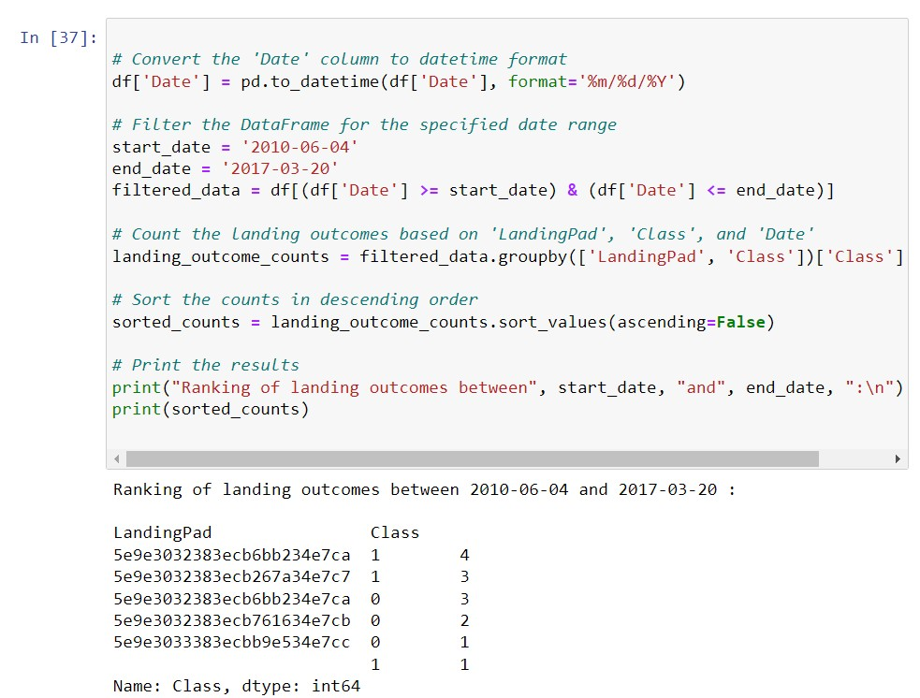
Rank Landing Outcomes Between 2010-06-04 and 2017-03-20
Here, the rank the count of landing outcomes (such as Failure (drone ship) or Success (ground pad)) between the date 2010-06-04 and 2017-03-20, in descending order is presented

Slide 35

Section 3

Slide 36
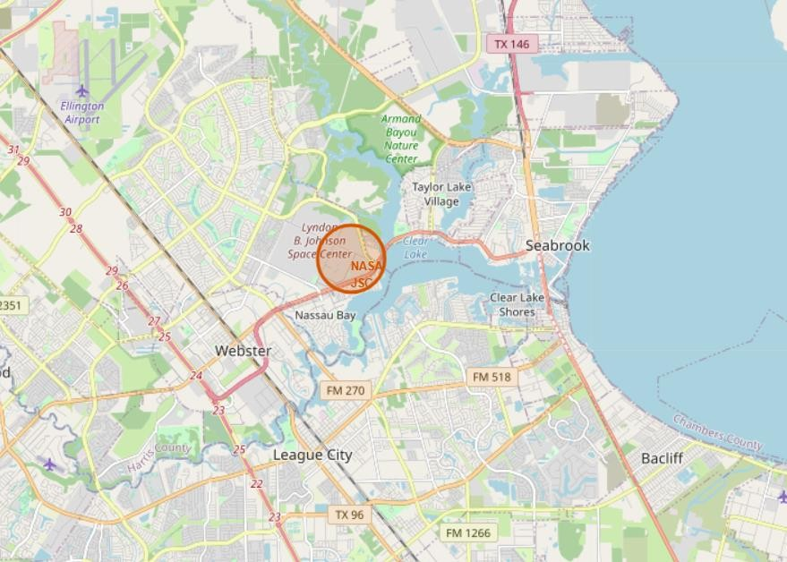
Folium Map Screenshot 1

Slide 37
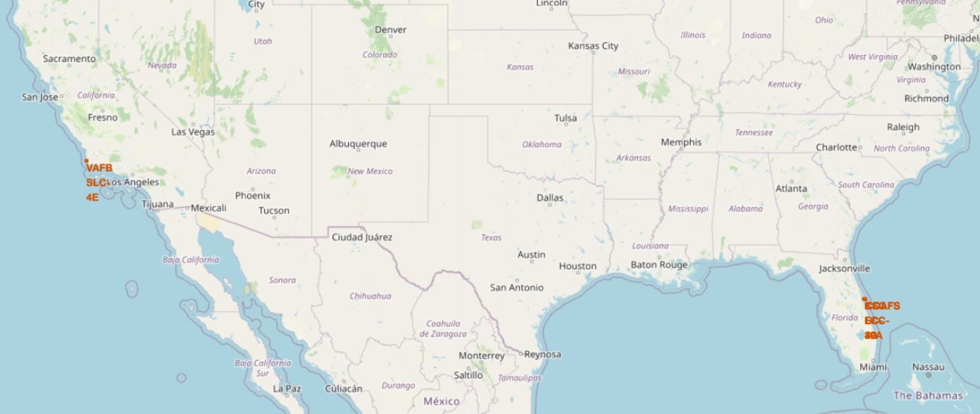
Folium Map Screenshot 2

Slide 38

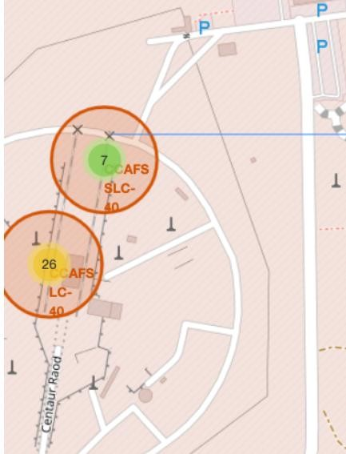
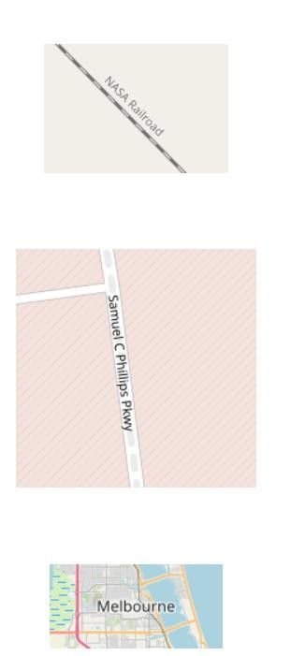
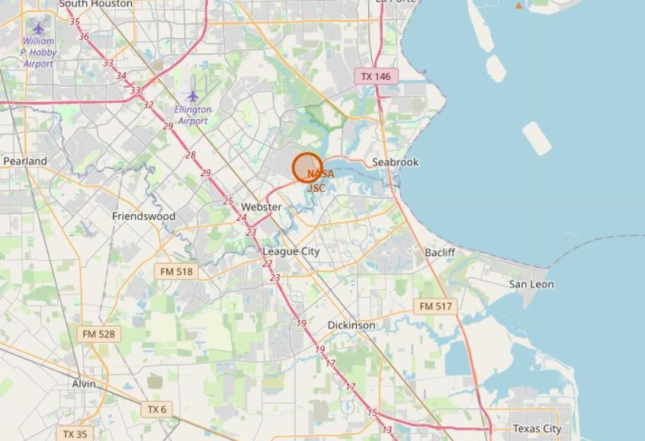
Folium Map Screenshot 3

Slide 39

Section 4

Slide 40
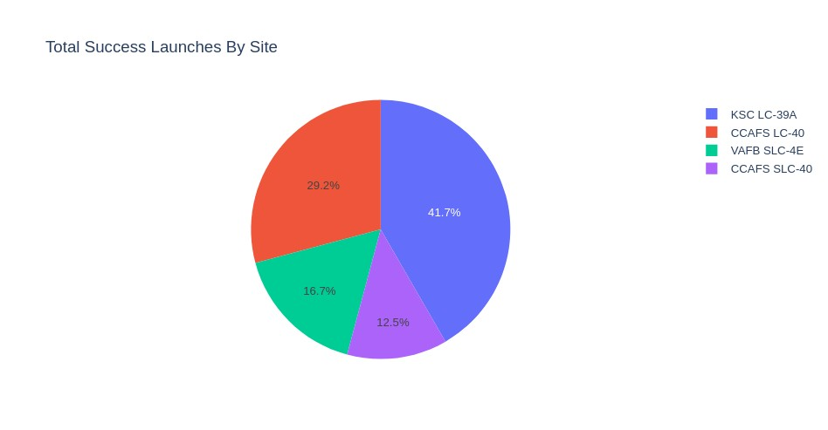
Dashboard Screenshot 1
The place from where launches are done seems to be a very important factor of
success of missions.

Slide 41
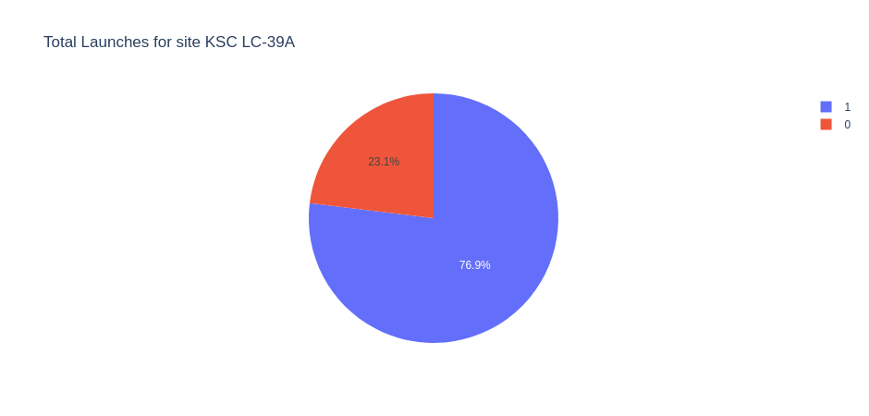
Dashboard Screenshot 2
76.9% of launches are successful in this site.

Slide 42

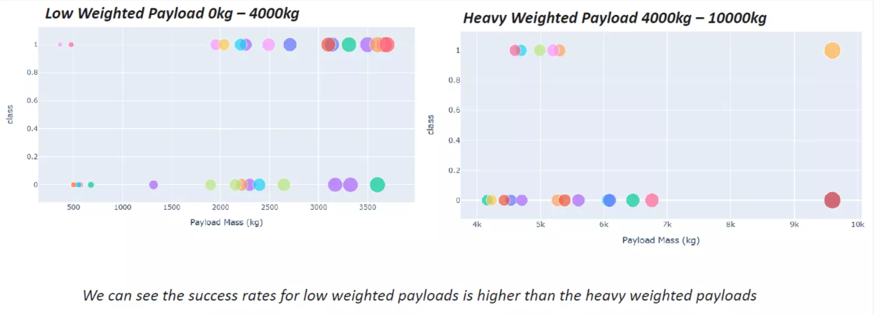
Dashboard Screenshot 3

Slide 43

Section 5

Slide 44
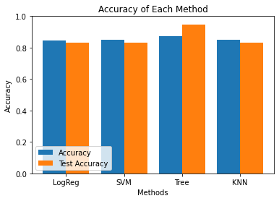
Classification Accuracy
Four classification models were tested, and their accuracies are plotted beside;
The model with the highest classification accuracy is Decision Tree Classifier, which has accuracies over than 87%.

Slide 45
Confusion Matrix

Slide 46
Conclusions
The SVM, KNN, and Logistic Regression models are the best in terms of prediction accuracy for this dataset.
Low weighted payloads perform better than the heavier payloads.
The success rates for SpaceX launches is directly proportional time in years they will eventually perfect the launches.
KSC LC 39A had the most successful launches from all the sites.
Orbit GEO,HEO,SSO,ES L1 has the best Success Rate.

Slide 47


